Slide 1
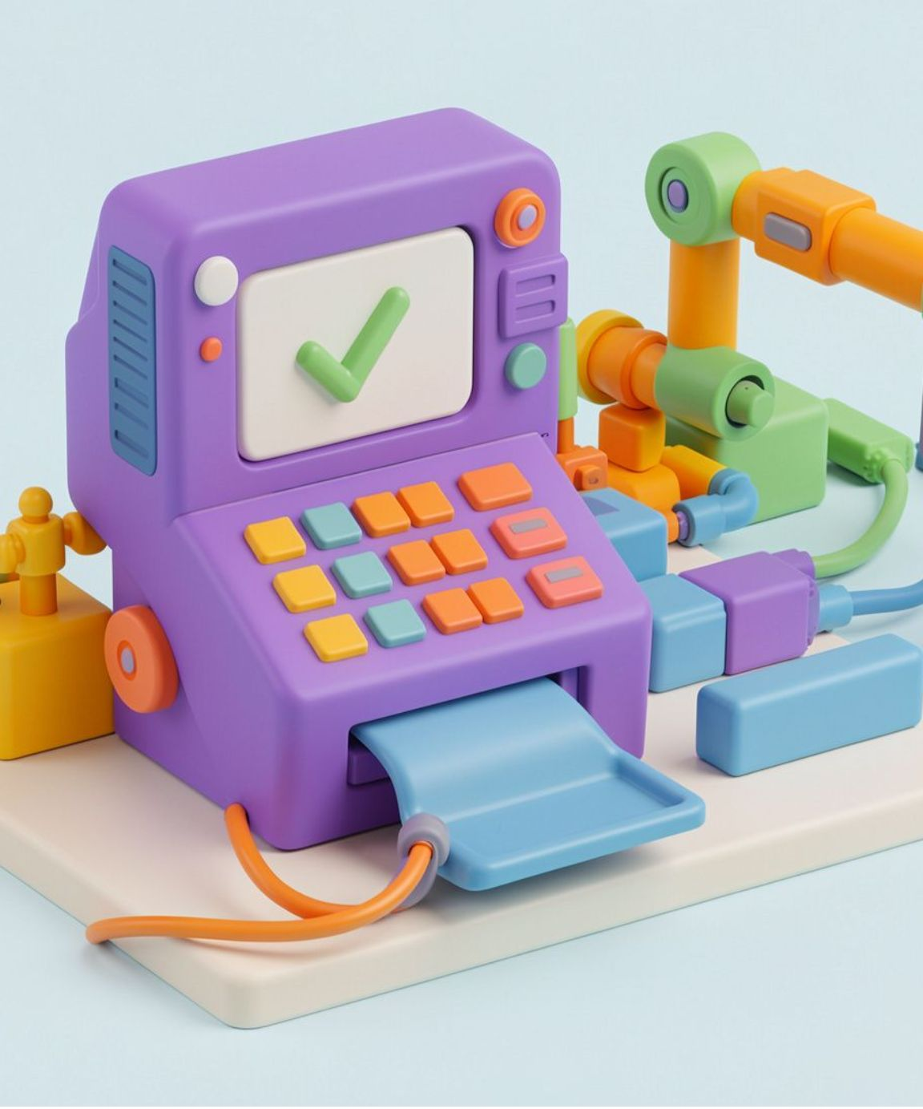


TESTING TYPES
Smoke / Sanity / Integration
Three checks, from quick confidence to connected systems.
Integration Testing
Smoke Testing
Sanity Testing
Checks whether different modules work together correctly.
Checks that the main features work after a new build.
Quickly checks whether a specific change or bug fix works correctly.
ATM example: It connects to the bank server and updates the balance after withdrawal.
ATM example: It starts, accepts a card, and shows the PIN screen.
ATM example: After a PIN fix, validation works as expected.

Slide 2
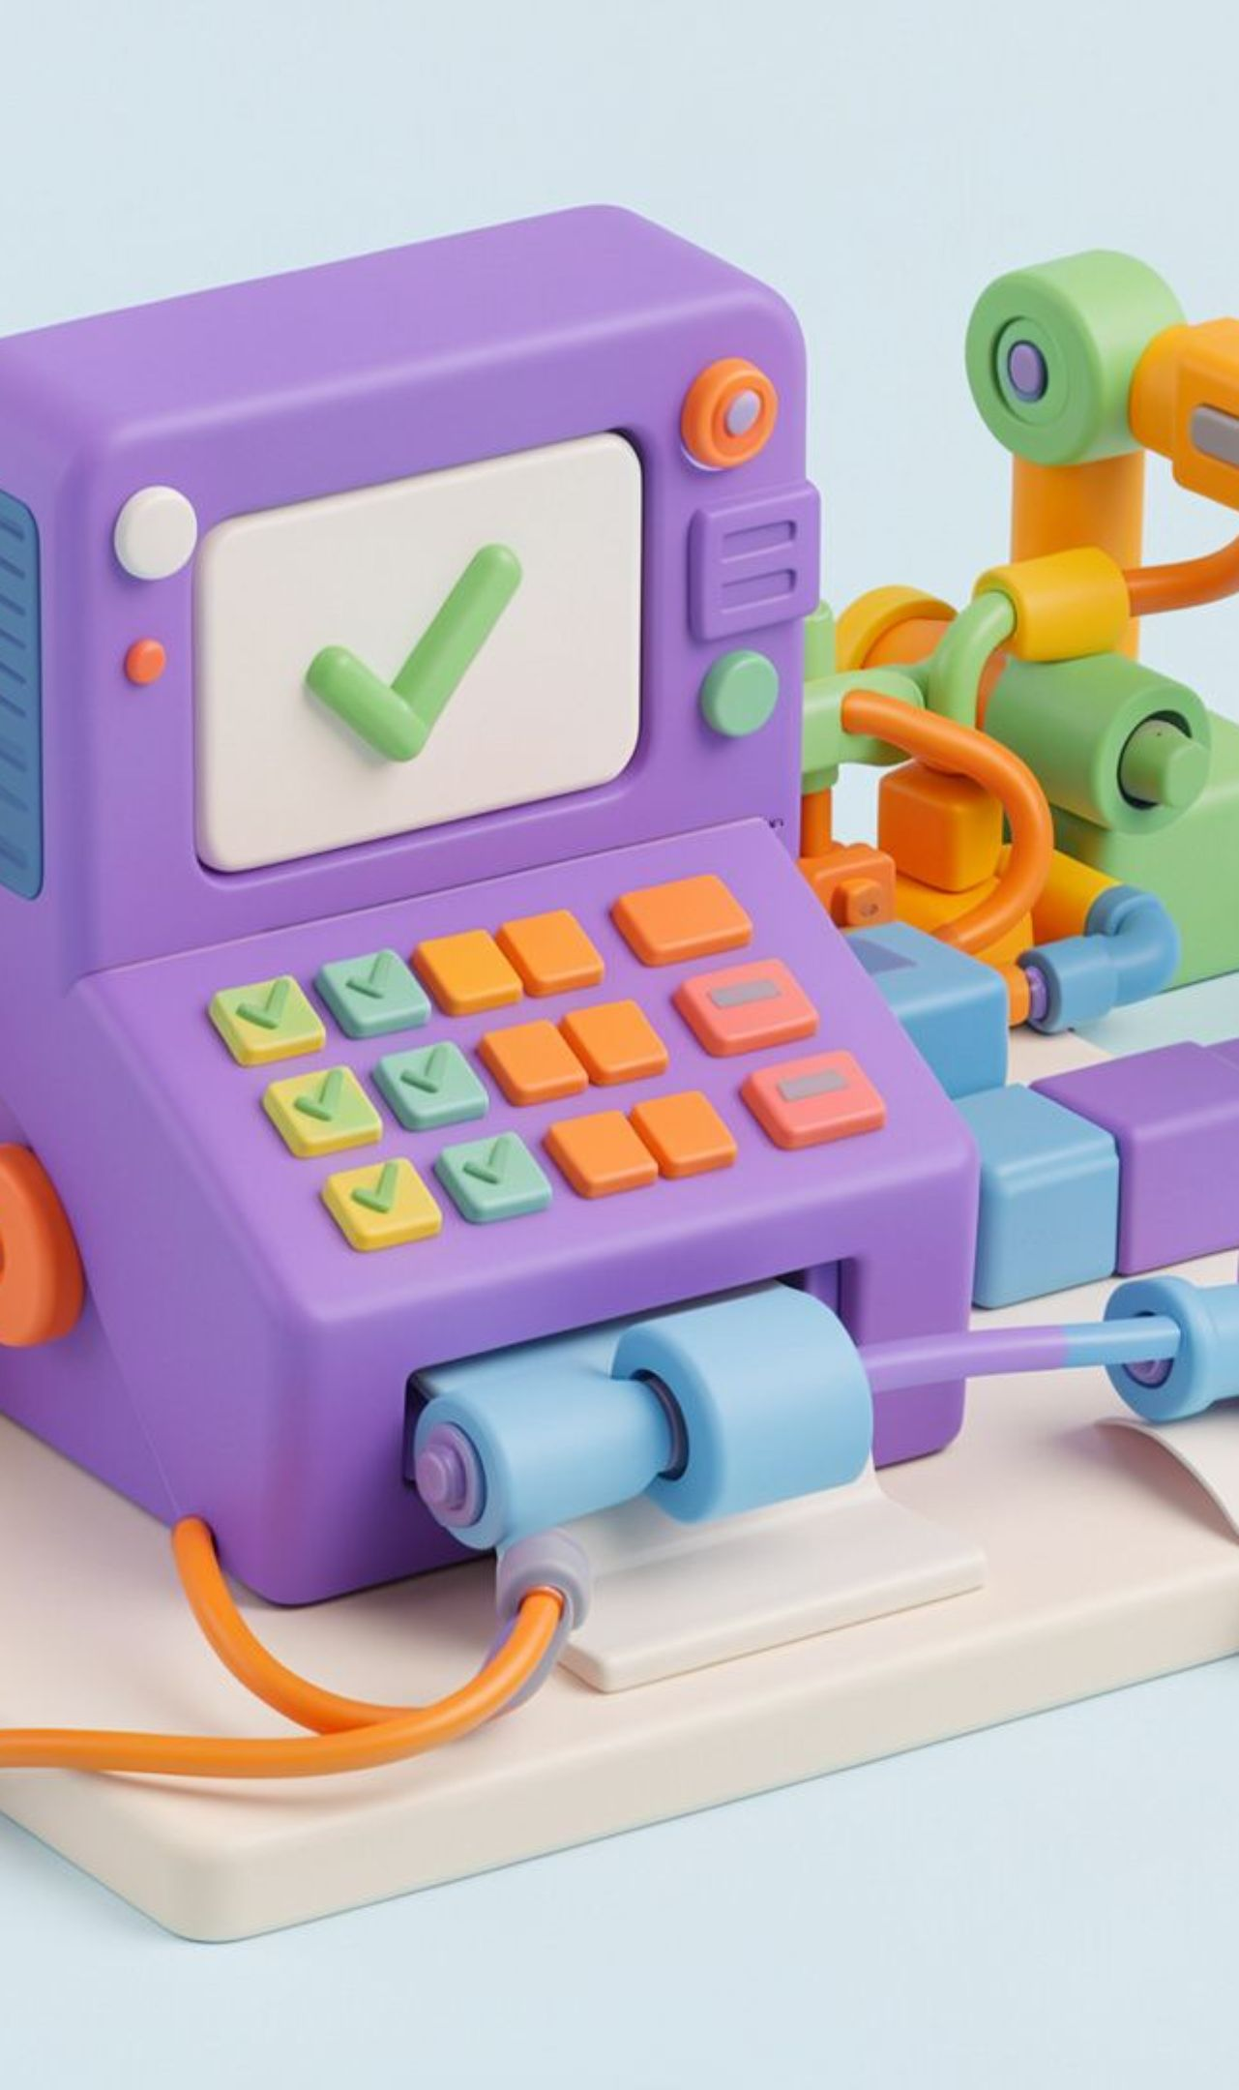



TESTING TYPES
System Testing / Regression Testing / User Acceptance Testing (UAT)
System Testing
Tests the complete application as a whole.
ATM example: Test the full ATM process, from card insertion to cash withdrawal and receipt generation.
Regression Testing
Checks that existing features still work after code changes.
ATM example: After updating the withdrawal feature, verify that balance enquiry still works.
User Acceptance Testing (UAT)
Checks whether the application meets users’ needs before release.
ATM example: Bank staff verify that the ATM works correctly for everyday customer transactions.

Slide 3
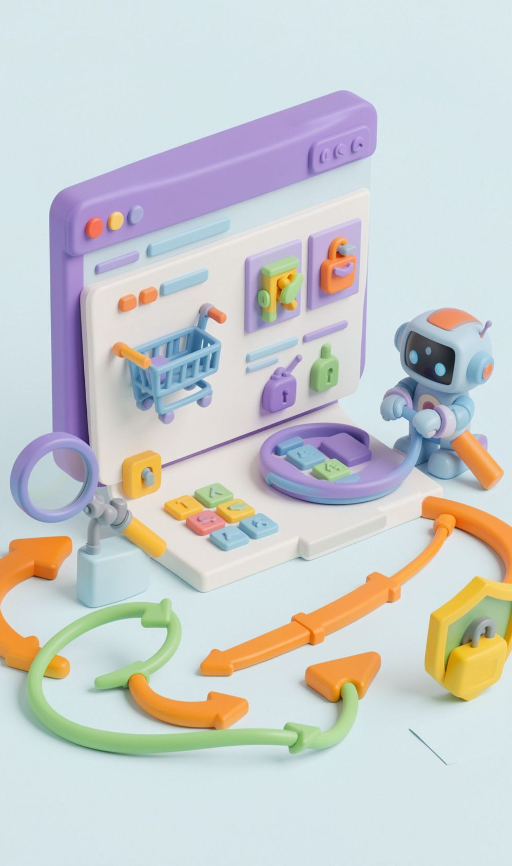



TESTING TYPES
Non-Functional Testing Types
Non-functional testing checks how well an application works, including usability, security, and behavior beyond specific business functions.
Usability Testing
Checks whether the application is easy to learn, understand, and use.
Example: A tester checks whether a first-time user can easily find a product, add it to the cart, and place an order on an online shopping website.
Security Testing
Checks whether the application protects user data and prevents unauthorized access.
Example: A tester tries to log in to a banking application using an incorrect password and checks whether one user can access another user's account.
Ad-Hoc / Exploratory Testing
Testers explore the application without strictly following predefined test cases to discover unexpected bugs. They learn, design, and execute tests as they go.
Example: A tester randomly clicks buttons, enters unusual inputs, refreshes pages, and navigates quickly through a shopping website to find unexpected errors.

Slide 4


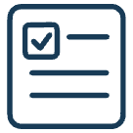

QA PRINCIPLES
QA Principles: Testing Finds Risk Early
1. Testing Shows the Presence of Defects
Testing finds bugs, but cannot guarantee that software is 100% bug-free.
Example: A calculator correctly adds 2 + 3, but gives the wrong answer for 5 × 4.
2. Exhaustive Testing Is Not Possible
Testing every possible input is impossible, so we test important cases.
Example: Instead of trying every password on a login page, we test a correct password and an incorrect password.
3. Early Testing
Testing should start as early as possible to find problems sooner.
Example: A tester finds a spelling mistake in a button label while reviewing the design, before the website is developed.

Slide 5



QA PRINCIPLES
QA Principles: Focus Where Defects Cluster
4. Defect Clustering
Most bugs are often found in a few parts of an application.
Example: A shopping app has many bugs on its payment page but very few on its home page.
5. Pesticide Paradox
Repeating the same tests may stop finding new bugs, so we need new test cases.
Example: After checking a login page with a correct password many times, we also test empty fields and incorrect passwords.

Slide 6



QA PRINCIPLES
QA Principles: Match Testing to the Context
6. Testing Is Context-Dependent
Different applications need different types of testing.
Example: A calculator needs correct calculations, while a game needs smooth gameplay.
7. Absence-of-Errors Fallacy
Software can be free of bugs but still fail to meet users' needs.
Example: A calculator app works perfectly , but does not have a multiplication function that users need.

Slide 7
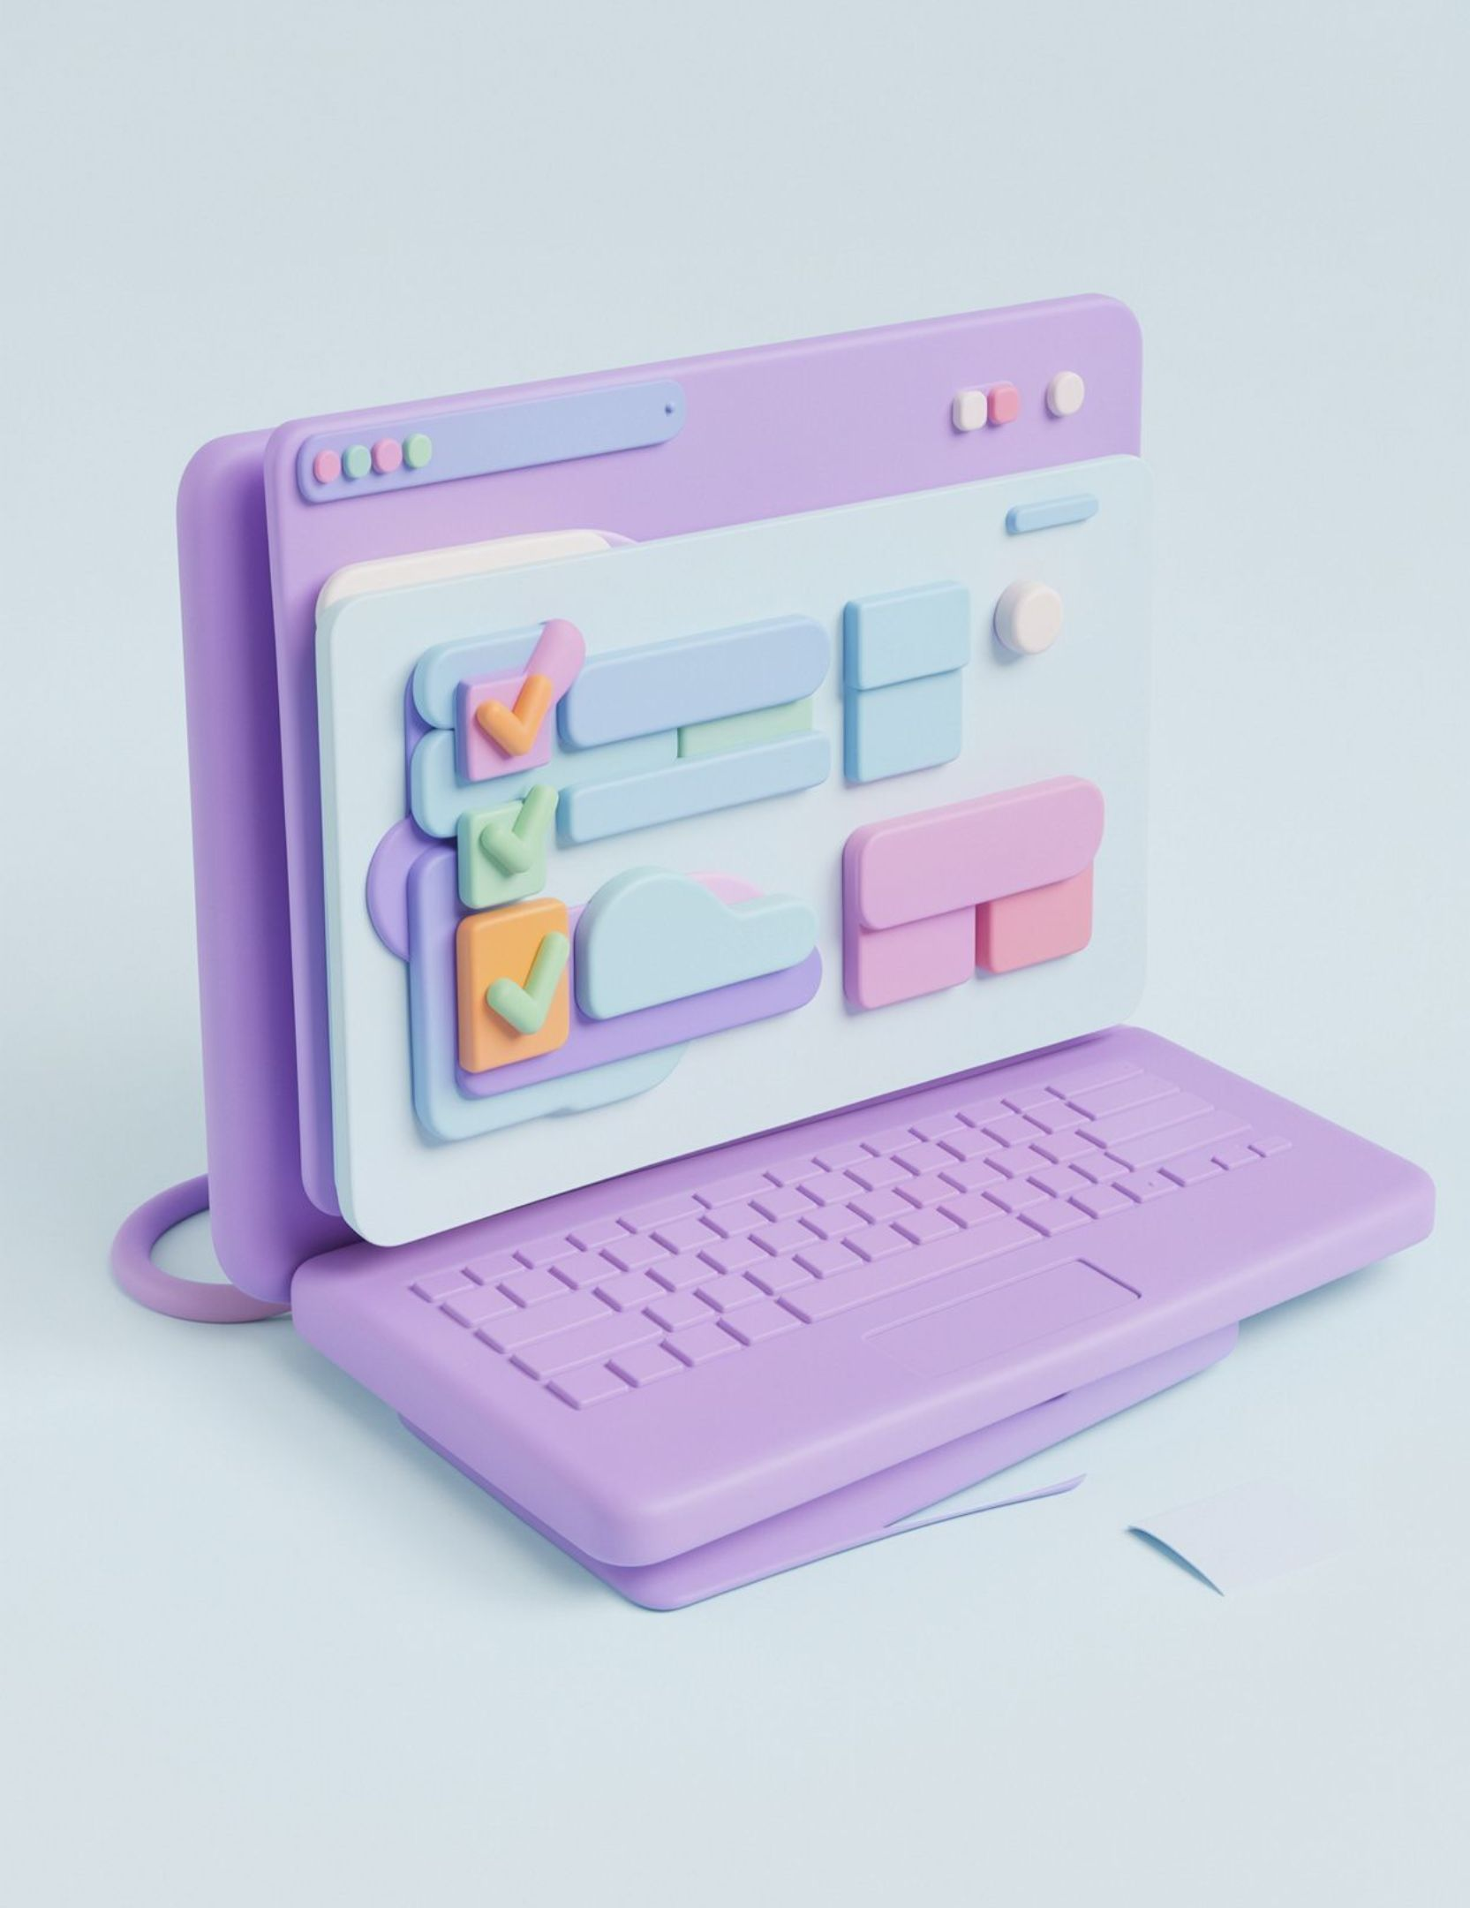
QA TERMS
Test Scenario
Explanation
Describes what functionality needs to be tested in an application.
Helps identify the different features that require testing.
Example
Check whether a user can log in to a website.
Check whether the website allows login with valid credentials.

Slide 8

QA TERMS
Test Case
Explanation
Describes the steps to test a particular functionality.
Specifies the actions and expected results to verify whether the feature works correctly.
Example
Open the website, enter a valid username and password, and click Login.
Verify that the user successfully reaches the home page.

Slide 9

Test Data in Software Testing
Definition
Test data is the input used to check whether software works correctly.
Key points
Tests real, invalid, boundary, and everyday inputs.
Finds defects across different scenarios.
Improves coverage and software quality.
Example
Login: valid details open the account; incorrect or empty details show an error.

Slide 10
Types of Test Data
Use the right data to test normal behavior, failures, limits, realism, and scale.
1
2
3
4
Valid Test Data
Invalid Test Data
Boundary Test Data
Null / Blank Test Data
Meets the rules and produces the expected result.
Breaks the rules to confirm errors are handled correctly.
Checks how required fields handle missing input.
Tests minimum, maximum, and just-inside/outside limits.
5
6
7
8
Random Test Data
Real Test Data
Synthetic Test Data
Large-Volume Test Data
Uses varied generated values to broaden coverage.
Mirrors real usage after sensitive data is protected.
Creates realistic test records without exposing private data.
Stress-tests performance with very large datasets.

Slide 11

QA DOCUMENTS
BRD — Business Requirements Document
A BRD explains what the business wants and what the application should do.
Key points
Captures business goals, user needs, and main requirements.
Uses simple language before development begins.
Example — Hospital Appointment Booking
Patients find doctors, book appointments, and receive confirmations. The goal is to reduce waiting time and make booking easier.

Slide 12
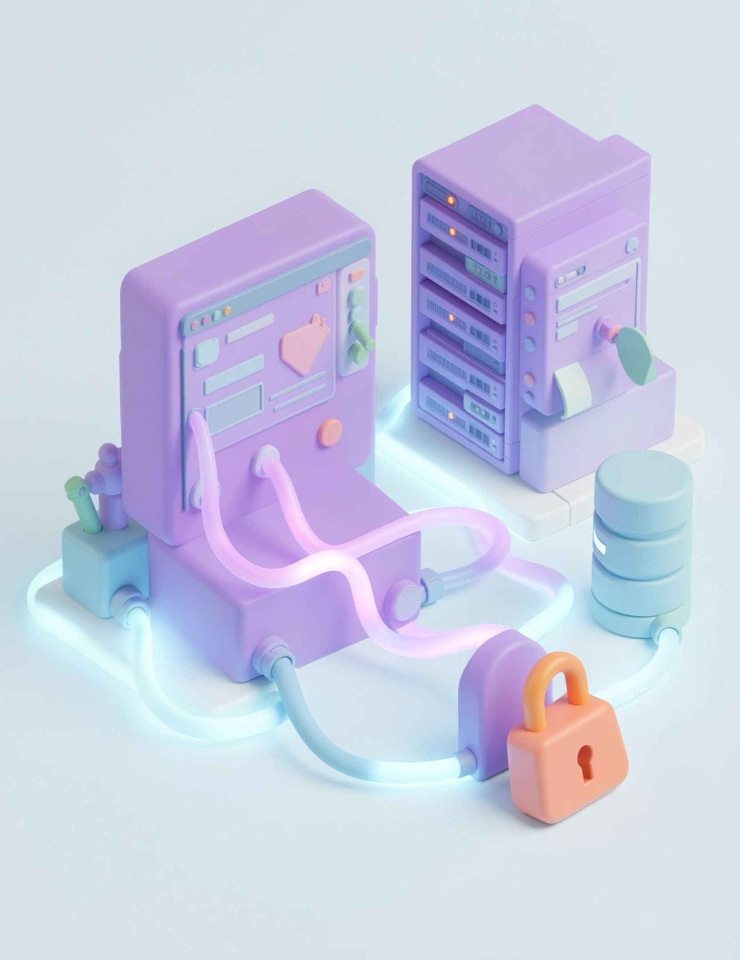
QA DOCUMENTS
TRD — Technical Requirements Document
A TRD explains the technical setup needed to build and protect the application.
Key points
Covers technologies, databases, APIs, security, and architecture.
Example — School Management System
React for the interface, Python FastAPI for the backend, PostgreSQL for student records, and secure login for students and teachers.

Slide 13
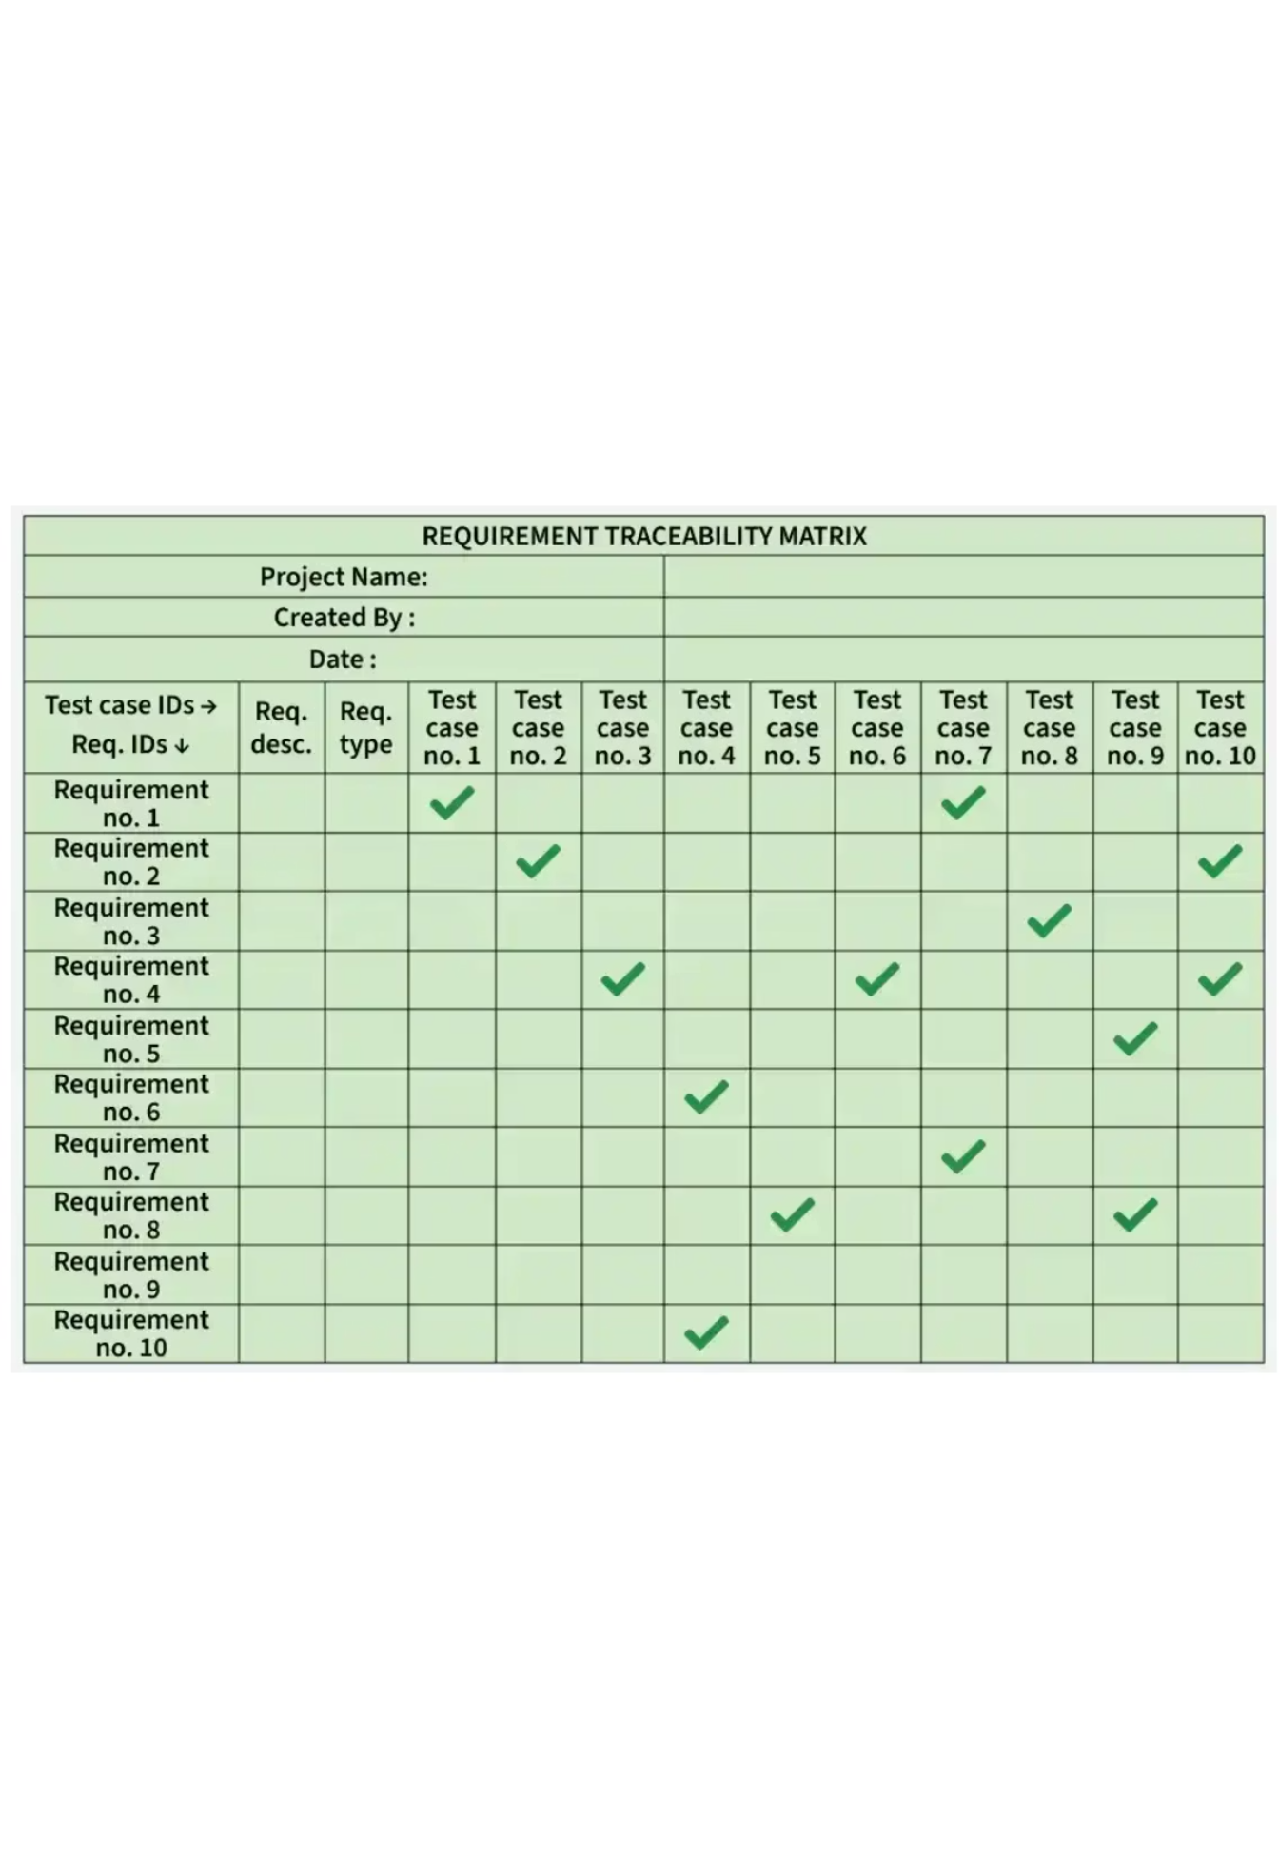
QA DOCUMENTS
RTM — Requirement Traceability Matrix
An RTM links each requirement to its test case so teams can track coverage.
Shows which requirements are covered, failed, or still untested.
Forward traceability: requirement → test case.
Backward traceability: test case → requirement.
Bidirectional traceability: both directions for complete coverage.
Example — Movie Ticket Booking
R01 Login → TC01 Pass; R02 Select seats → TC02 Pass; R03 Payment → TC03 Fail; R04 Download ticket → TC04 Not tested.
Green ticks show a link between a requirement and test case; they do not automatically mean the test passed.

Slide 14
QA DOCUMENTS
RTM Types
1
2
3
Forward Traceability
Backward Traceability
Bidirectional Traceability
Requirement → Test Case
Ensures every requirement has a matching test.
Test Case → Requirement
Confirms every test case belongs to a real requirement.
Requirement ↔ Test Case
Connects both directions for complete coverage and to find missing or unnecessary tests.
Example: The movie-seat requirement links to TC02.
Example: TC02 is checked against the movie-seat requirement.
Example: The movie-seat requirement links to TC02, and TC02 links back to that requirement.
Notes:
Walk through the three RTM directions: forward, backward, and bidirectional.

